Slide 1
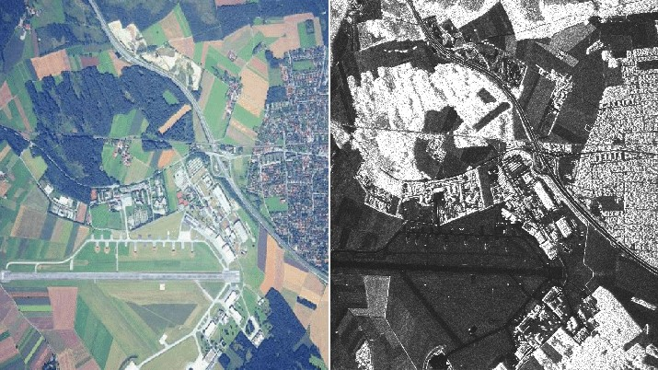
Fusion of optical and SAR images based on deep learning to reconstruct
vegetation NDVI time series in cloud-prone regions

Slide 2
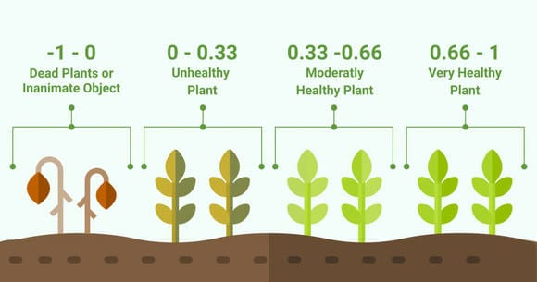
What is NDVI
Normalized difference vegetation index (NDVI)
Range -1 to 1
Vegetation monitoring and health evaluation

Slide 3
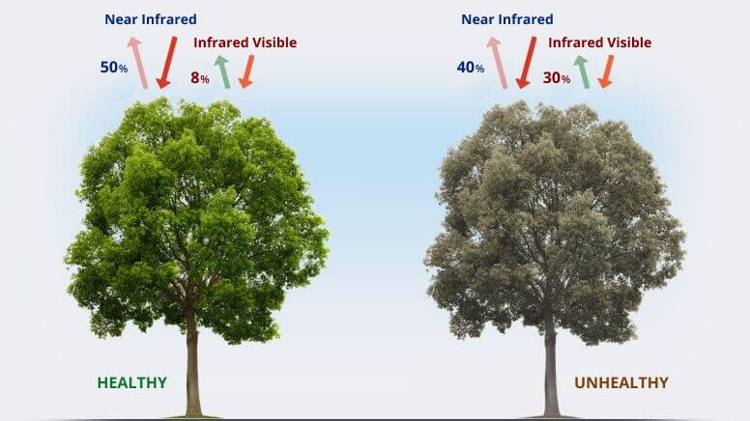
What is NDVI
NDVI = (NIR - Red) / (NIR + Red)

Slide 4
Why NDVI reconstruction required and How it can be done
Optical remote sensing data often suffer from a large amount of missing information due to sensor failures and harsh atmospheric conditions.
Synthetic aperture radar (SAR) offers a new approach to filling in missing optical data
Transformer Temporal-spatial Model (TTSM)

Slide 5
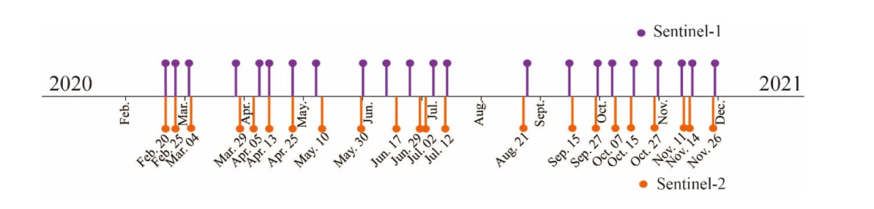
Study area and data preparation
south of the Songnen Plain, the south bank of the Songhua River, China
optical data was obtained from the Copernicus Sentinel-2 mission for the period from February 2020 to December 2020
All Sentinel-2 images used in this study were obtained from the Google Earth Engine (GEE) platform
10 m NDVI were obtained from the “B8′′ and ”B4′′ bands
SAR data were obtained from the Copernicus Sentinel-1 mission.
SAR image collection named “Copernicus/S1_GRD” in the GEE

Slide 6
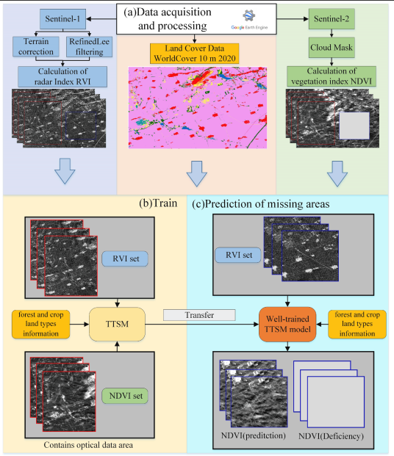
Study area and data preparation

Slide 7
Transformer Temporal-spatial Model (TTSM)
TTSM uses temporal and spatial dependencies of NDVI and RVI to predict the missing NDVI for cloudy regions.
Transformer uses multi head self-attention mechanism and positional embedding that allow parallel computation

Slide 8
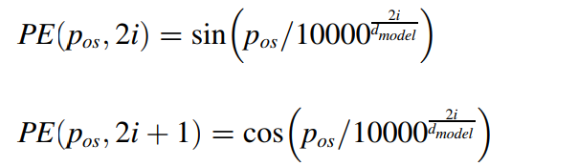
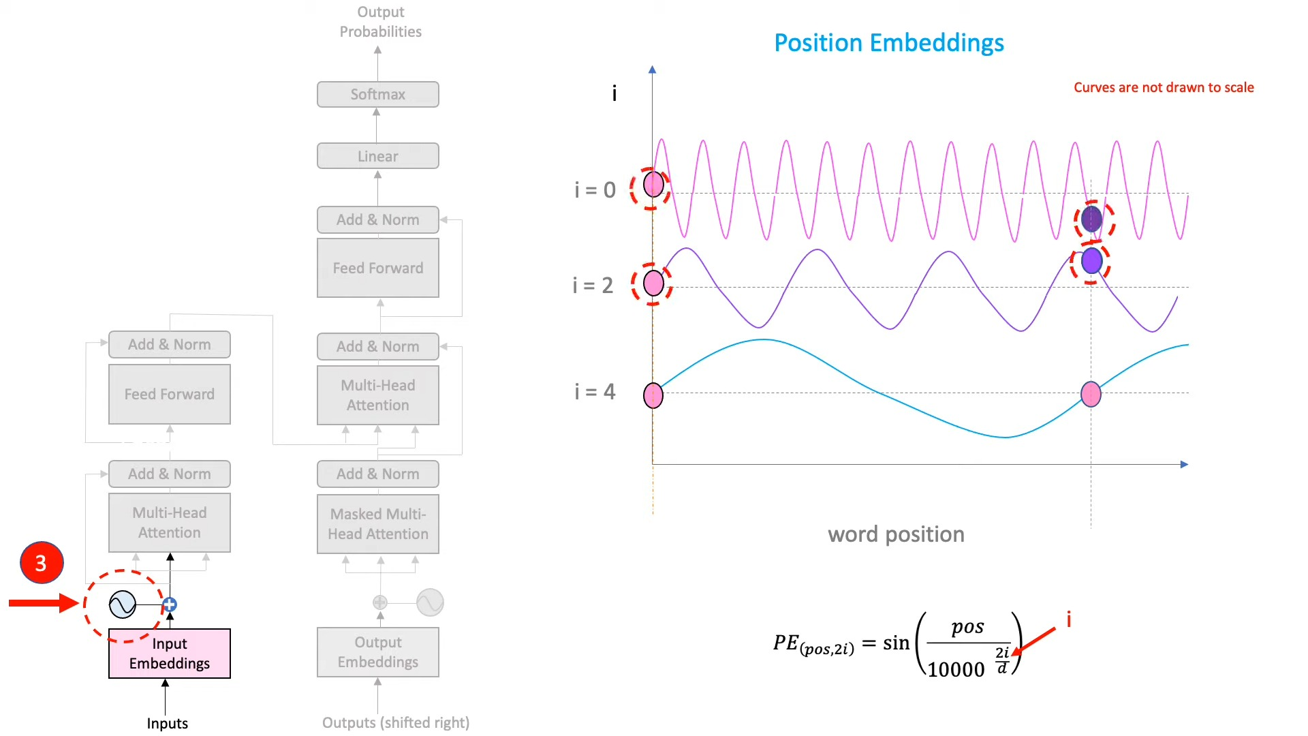
Transformer Temporal-spatial Model (TTSM)
Positional Embedding:

Slide 9
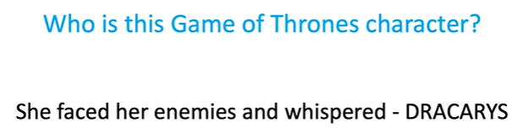
Transformer Temporal-spatial Model (TTSM)
Attention:

Slide 10
Transformer Temporal-spatial Model (TTSM)
Attention:

Slide 11

Transformer Temporal-spatial Model (TTSM)
Attention:
Daenerys targaryen

Slide 12
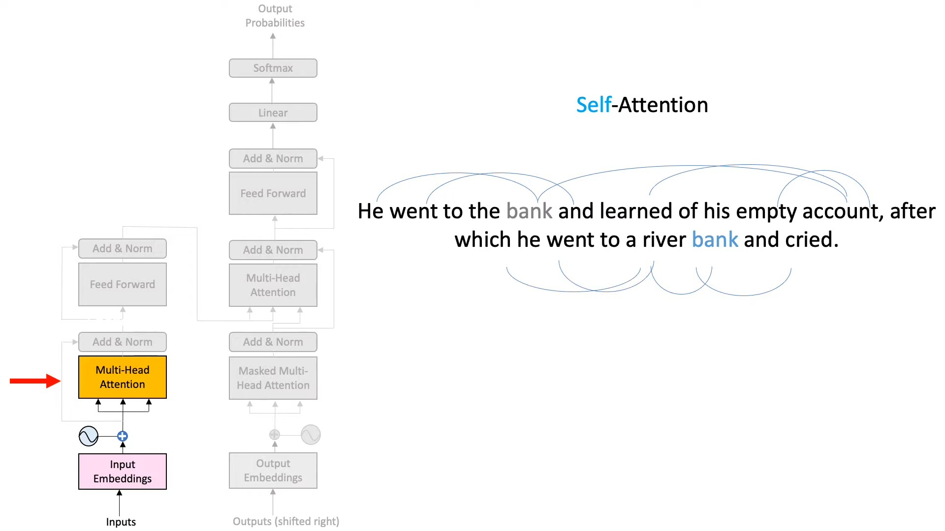
Transformer Temporal-spatial Model (TTSM)
Self-Attention:

Slide 13
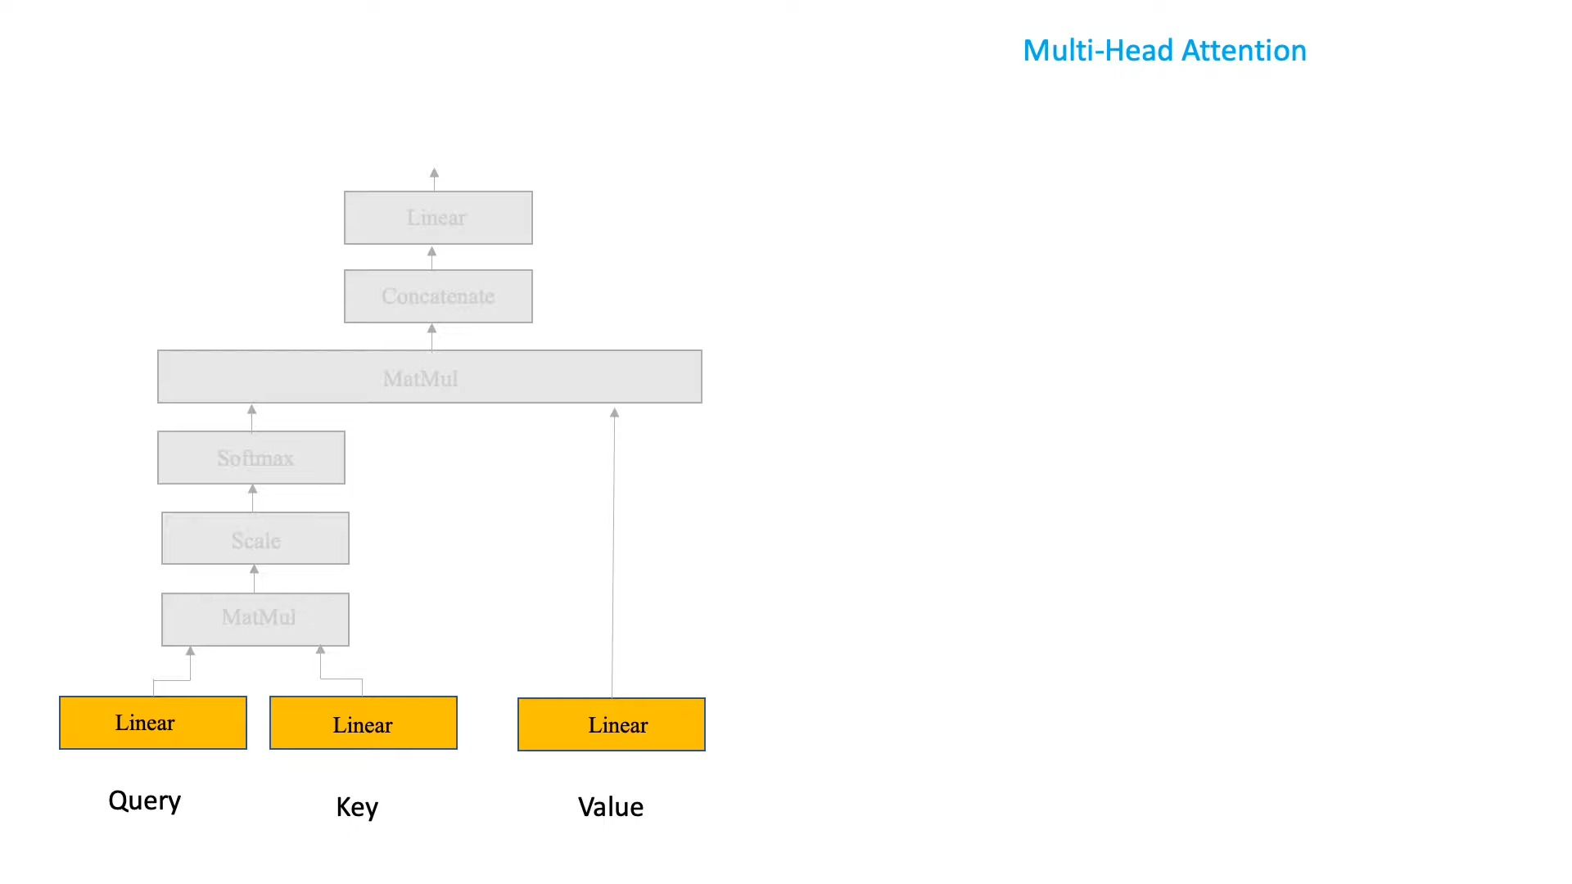
Transformer Temporal-spatial Model (TTSM)
Multi-Head Attention:

Slide 14

Transformer Temporal-spatial Model (TTSM)
Multi-Head Attention:

Slide 15
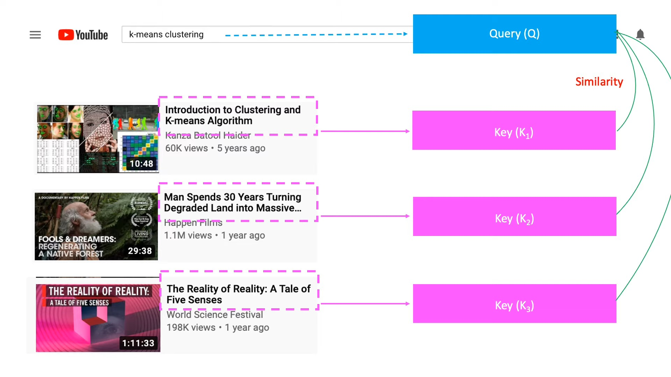
Transformer Temporal-spatial Model (TTSM)
Multi-Head Attention:

Slide 16
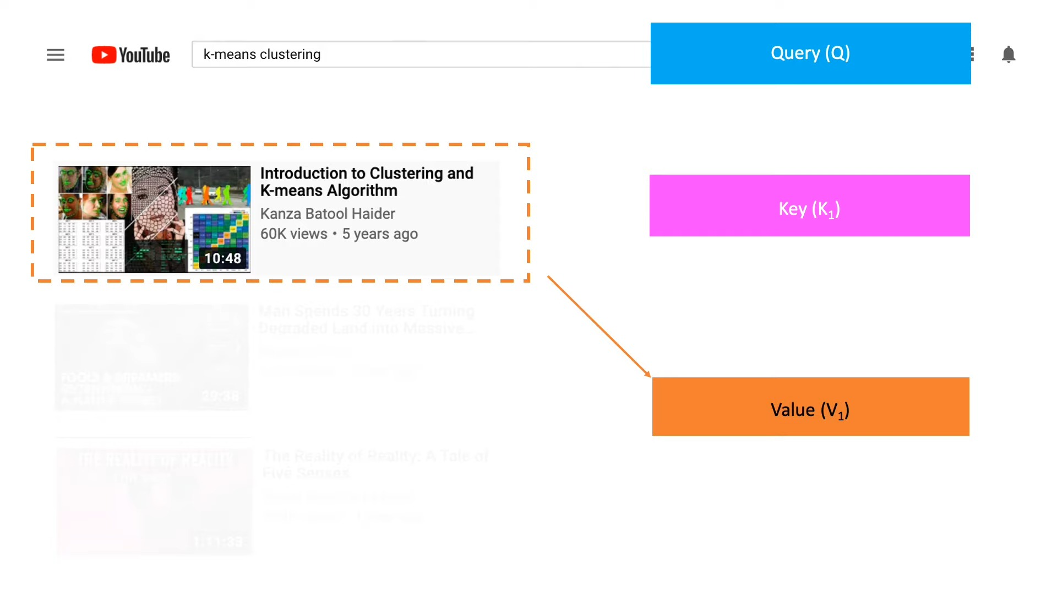
Transformer Temporal-spatial Model (TTSM)
Multi-Head Attention:

Slide 17
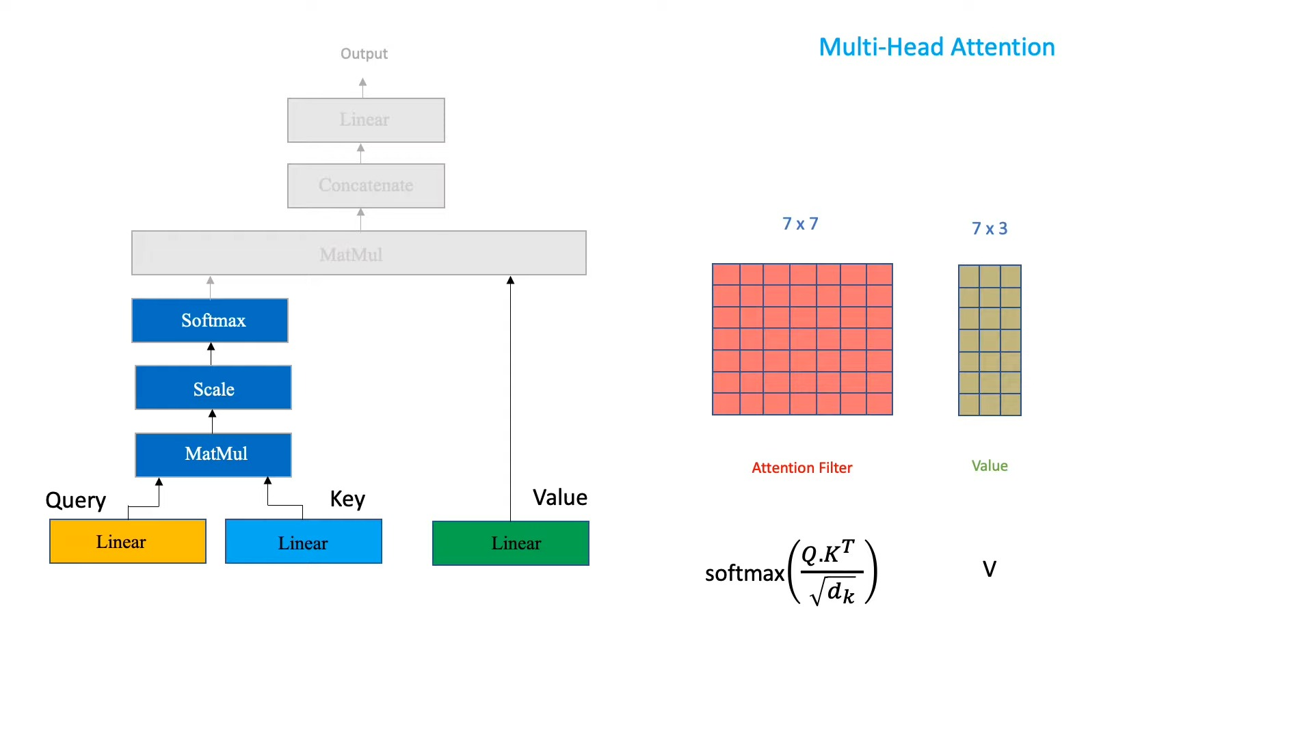
Transformer Temporal-spatial Model (TTSM)
Multi-Head Attention:

Slide 18
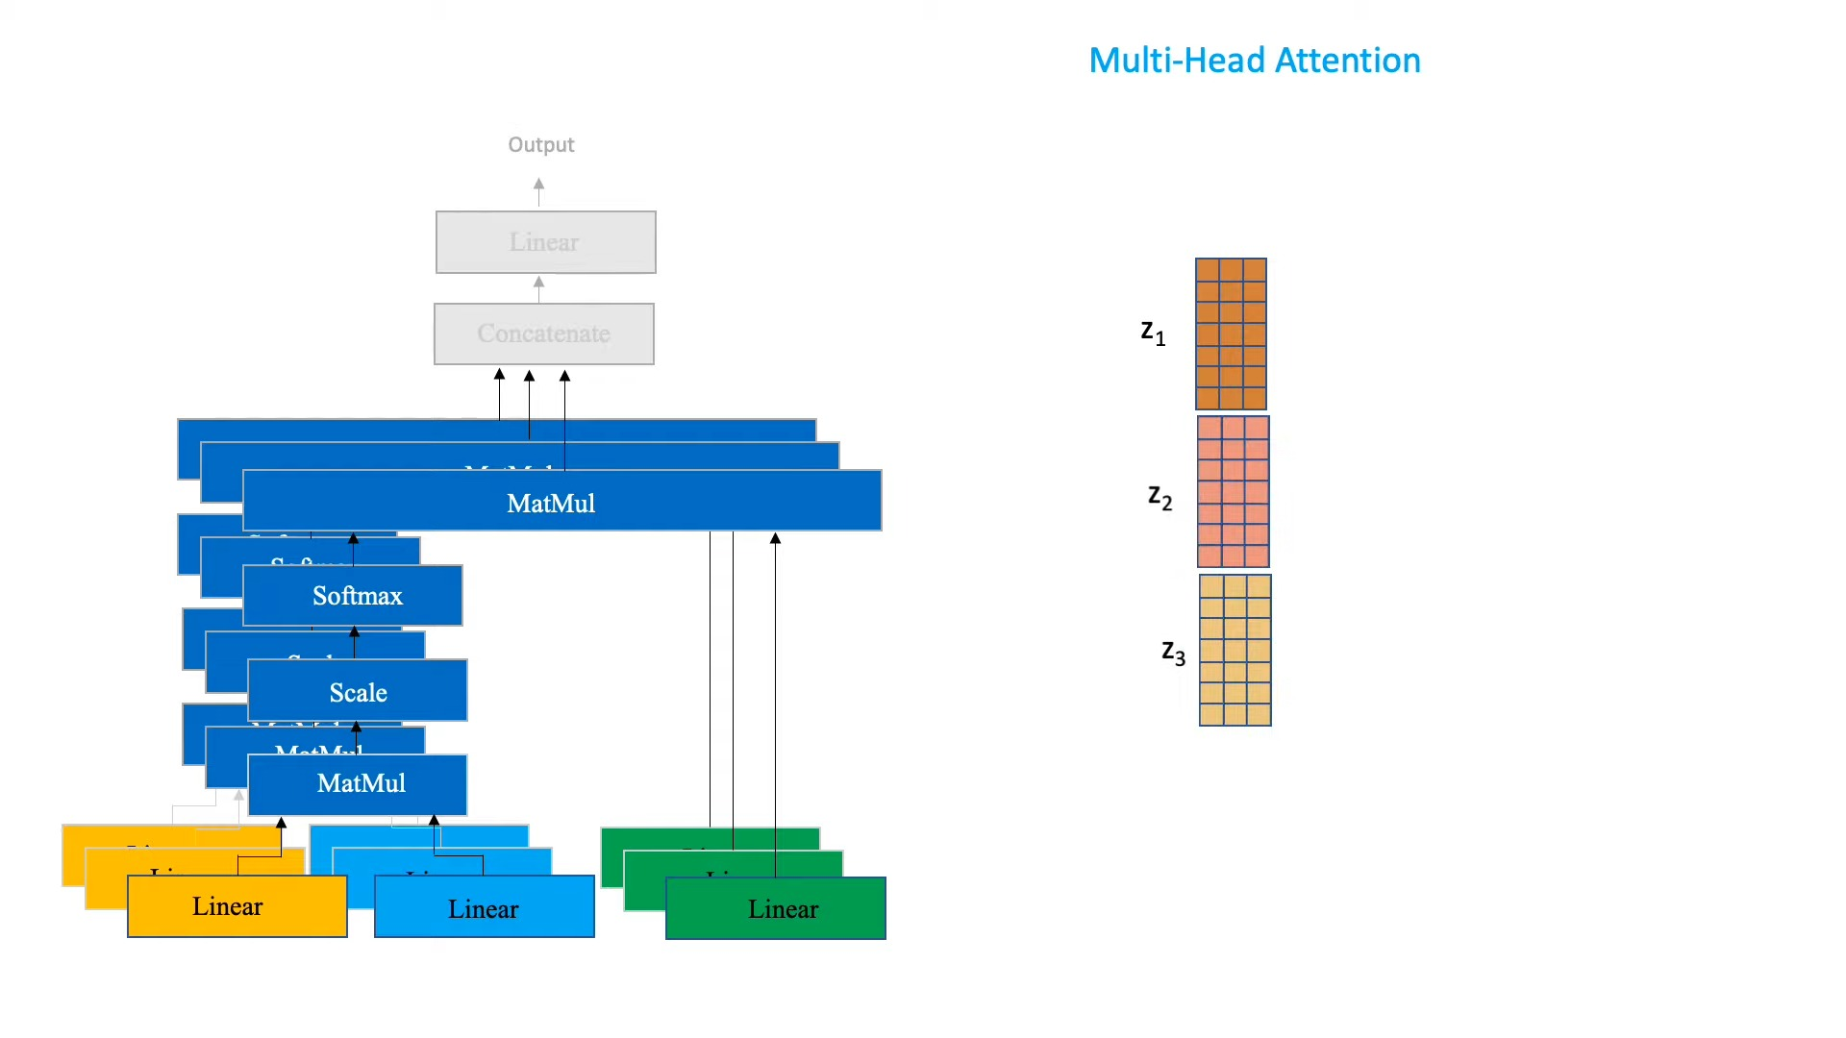
Transformer Temporal-spatial Model (TTSM)
Multi-Head Attention:

Slide 19
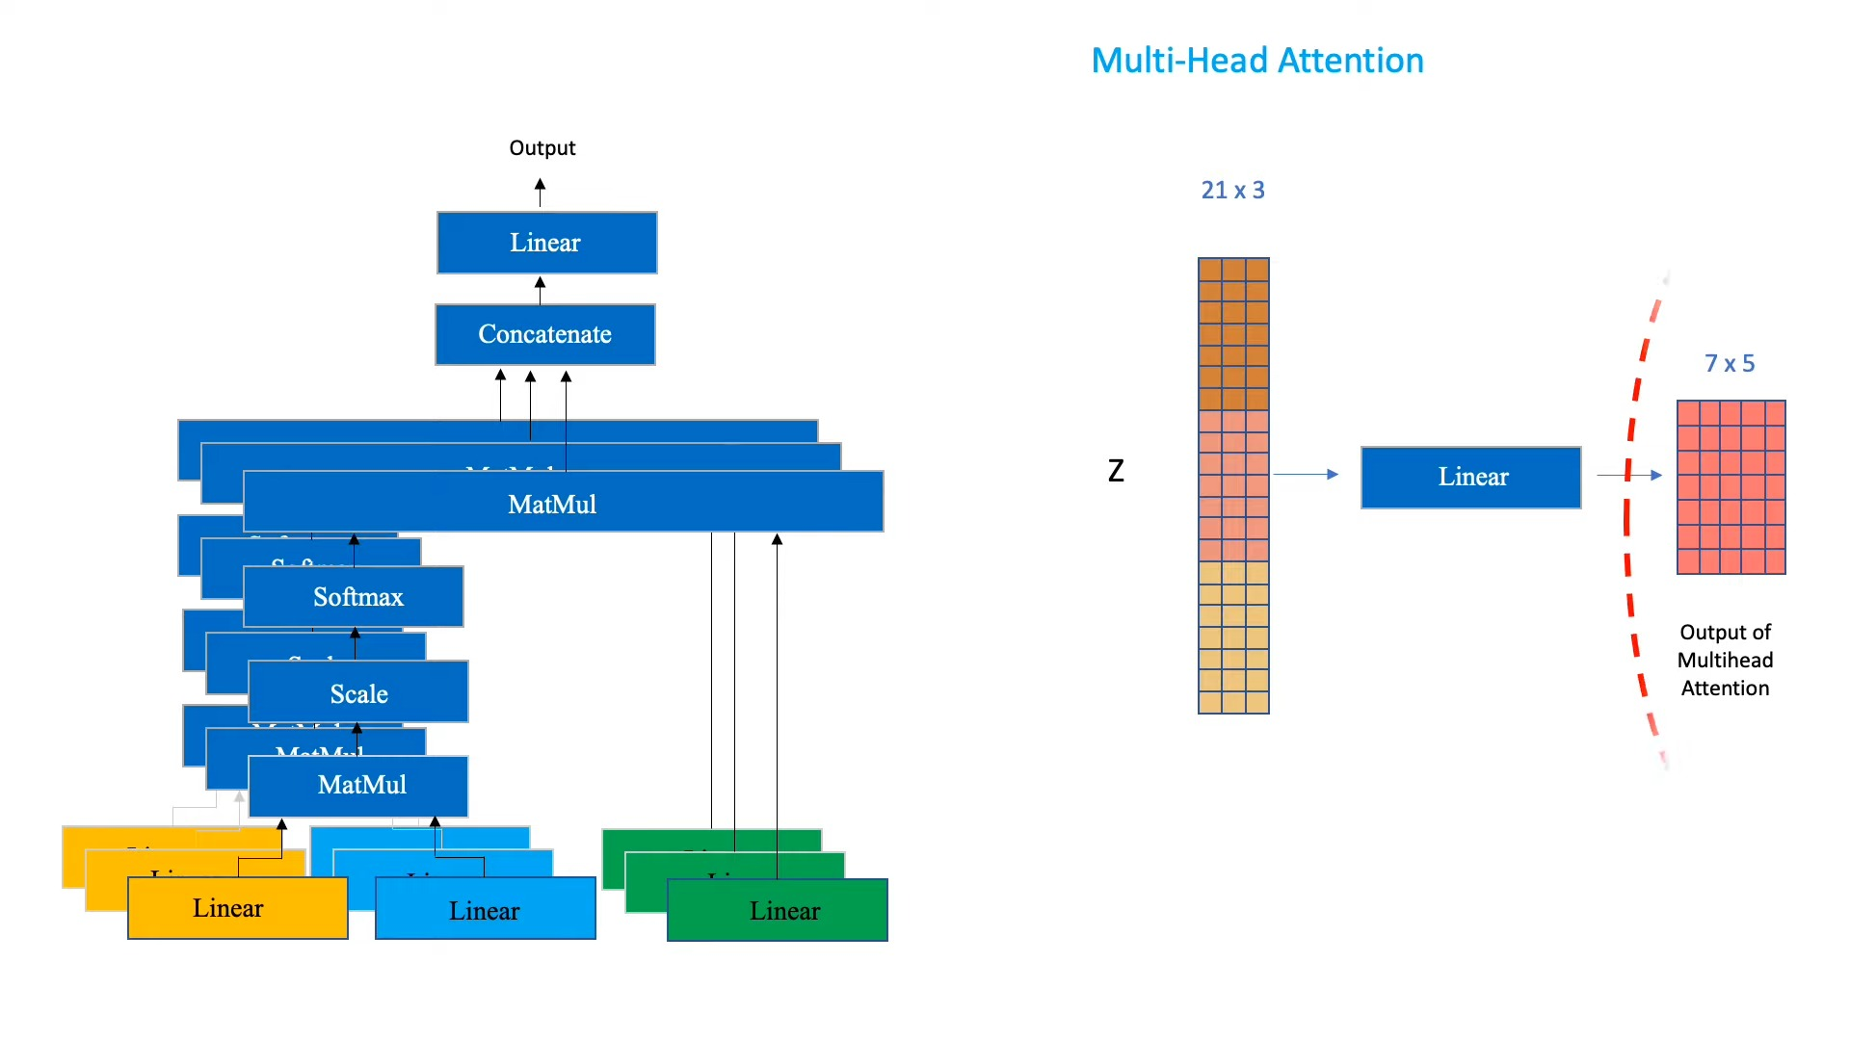
Transformer Temporal-spatial Model (TTSM)
Multi-Head Attention:

Slide 20
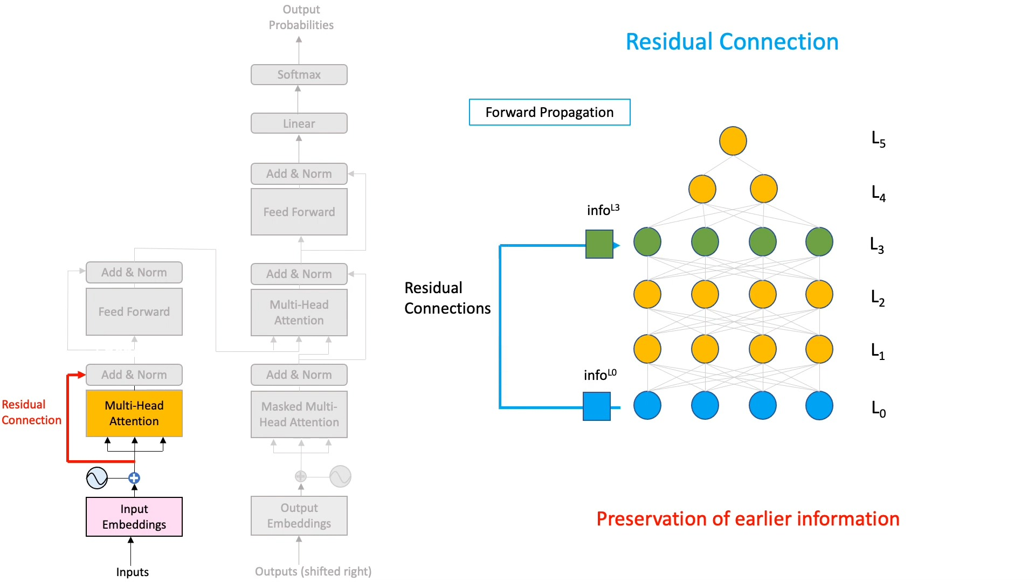
Transformer Temporal-spatial Model (TTSM)

Slide 21
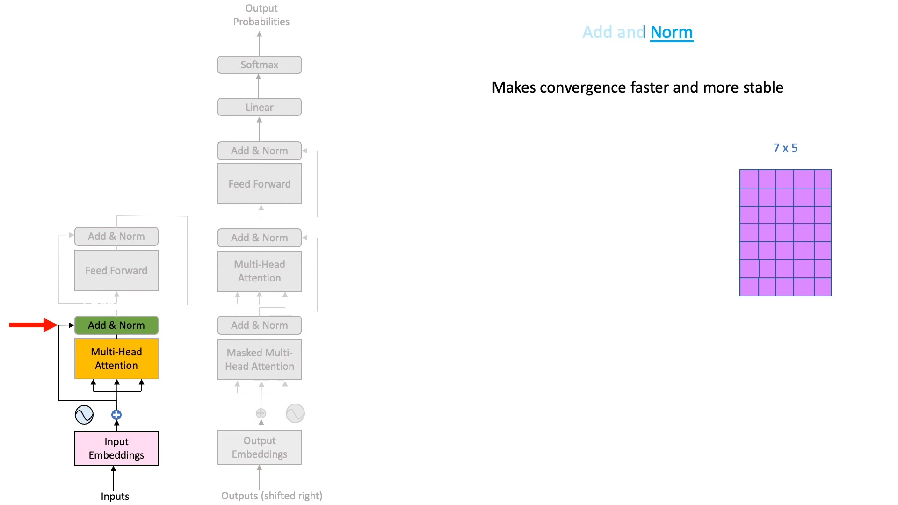
Transformer Temporal-spatial Model (TTSM)

Slide 22
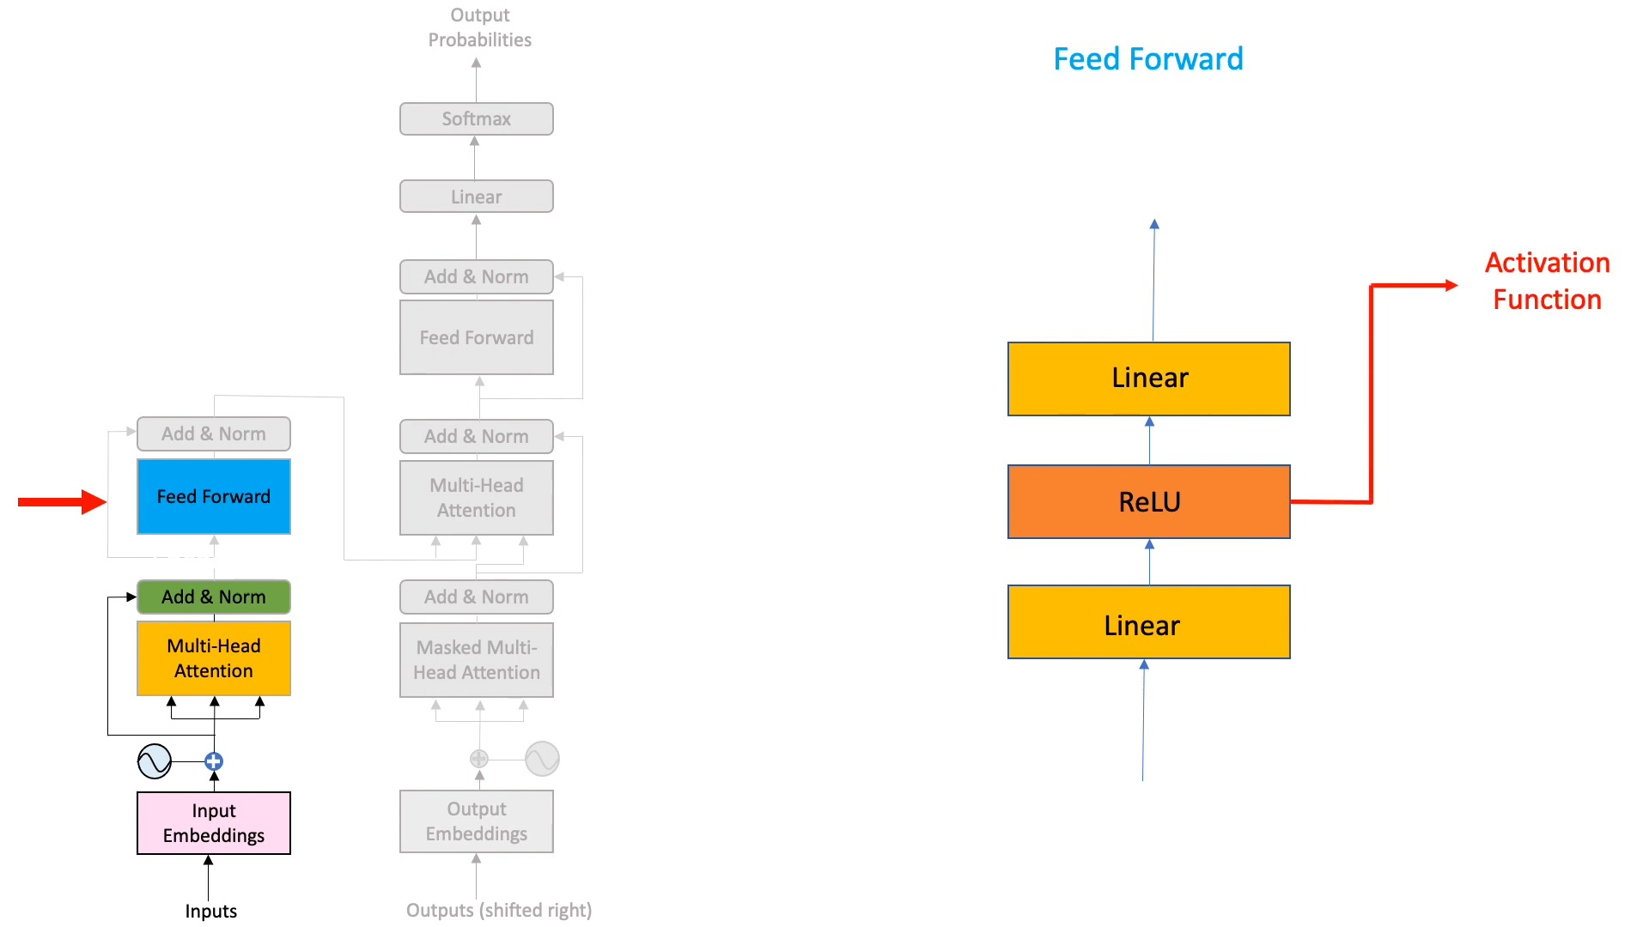
Transformer Temporal-spatial Model (TTSM)

Slide 23
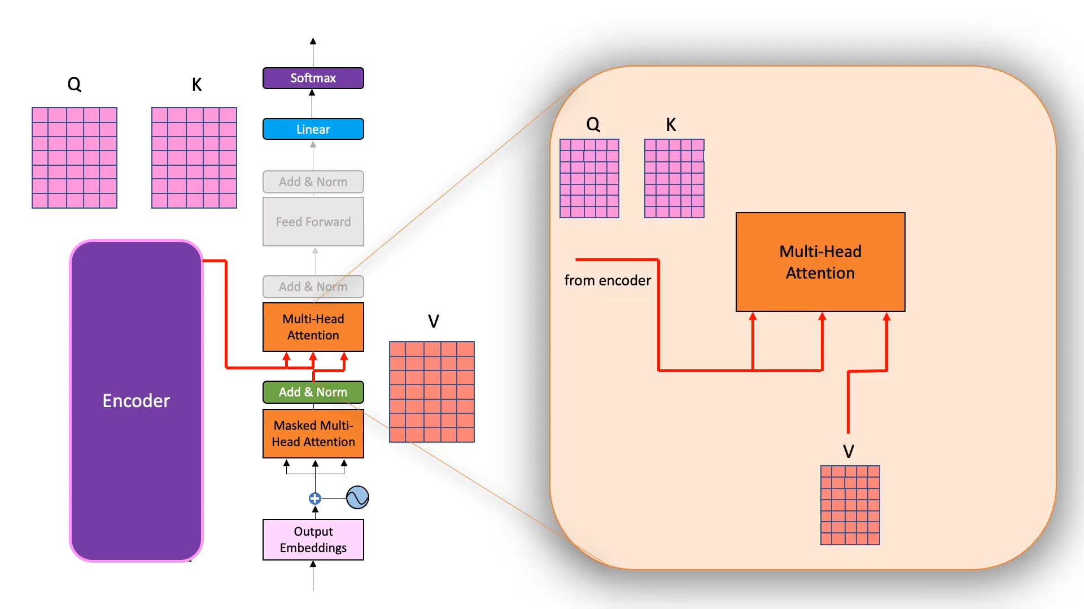
Transformer Temporal-spatial Model (TTSM)
Decoder:

Slide 24
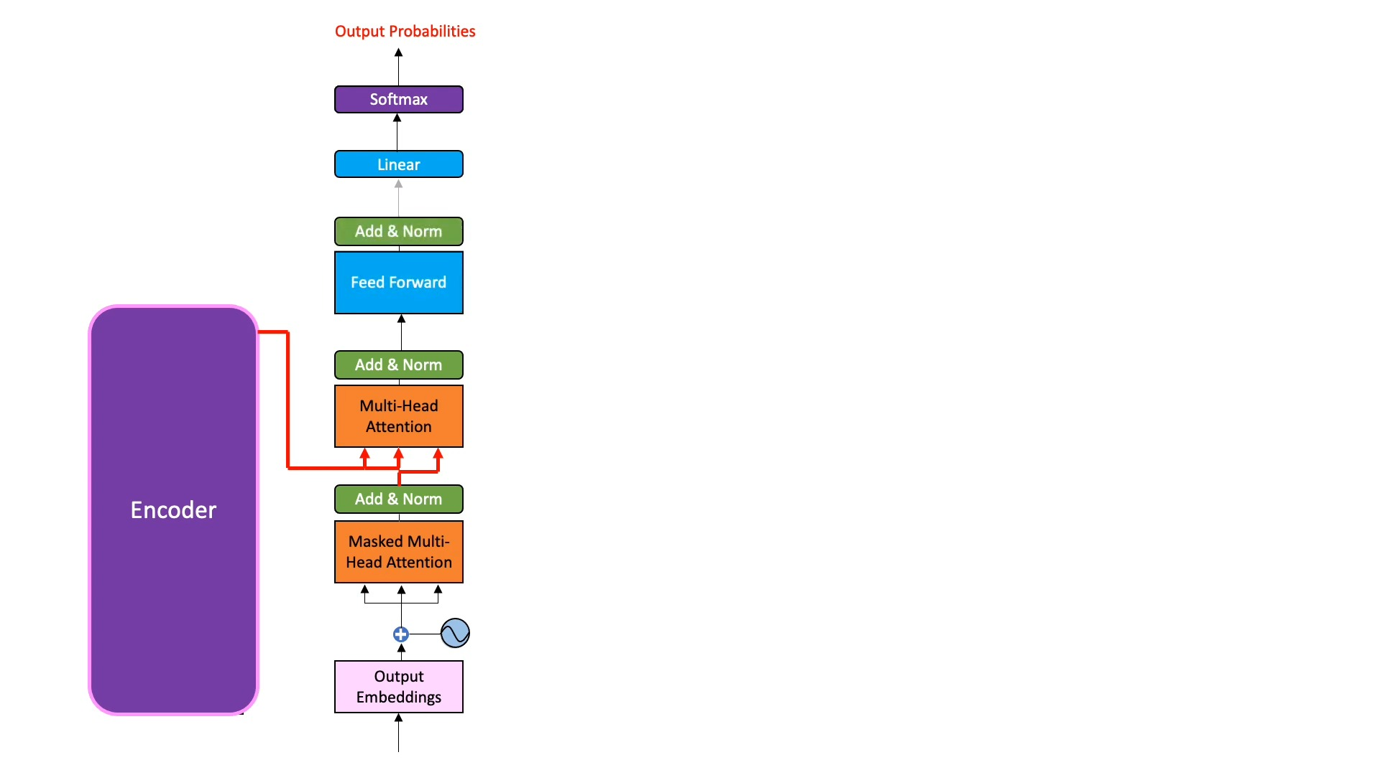
Transformer Temporal-spatial Model (TTSM)
Decoder:

Slide 25
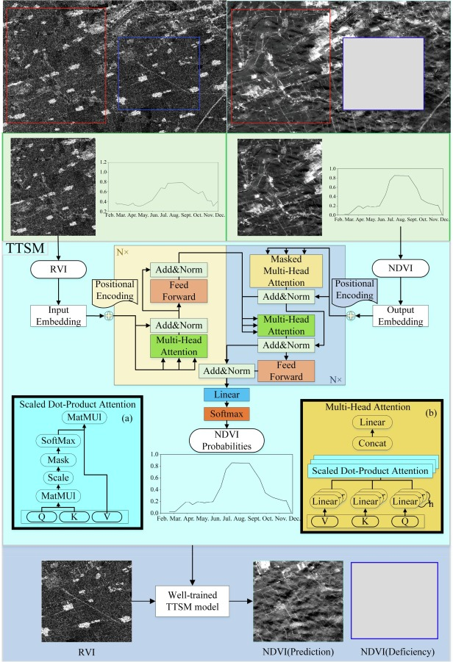
Transformer Temporal-spatial Model (TTSM)

Slide 26
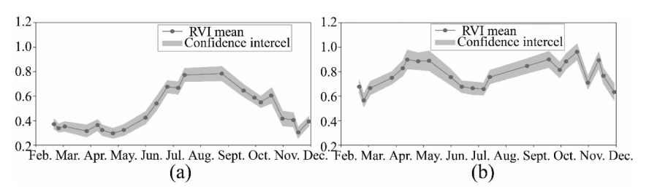
Prediction consistency of time series NDVI
this study selected crop, forest
separate model was trained using the crop and forest pixels of the NDVI and RVI time series

Slide 27
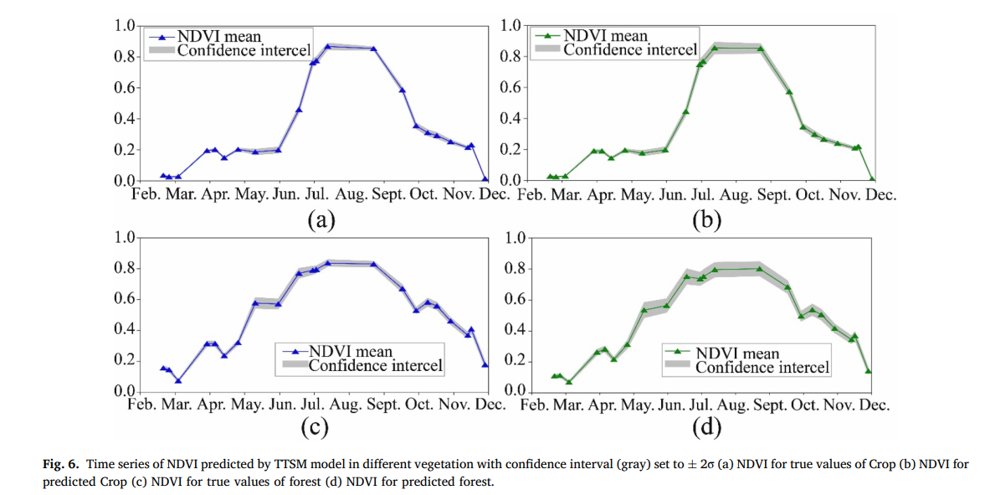
Prediction consistency of time series NDVI

Slide 28
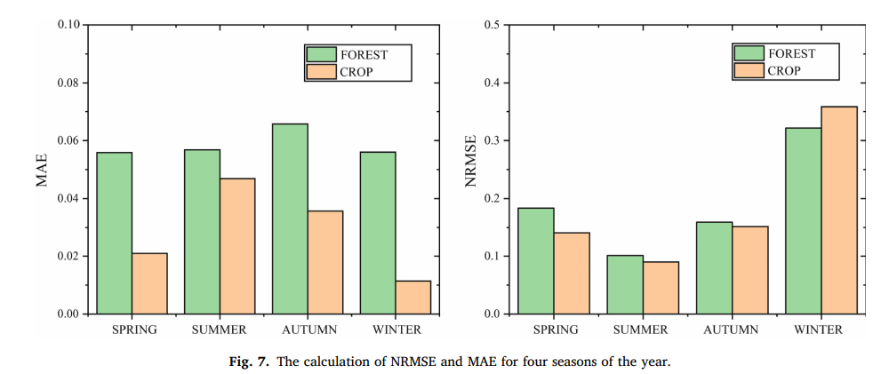
Seasonal analysis of prediction NDVI errors of different vegetation
types

Slide 29
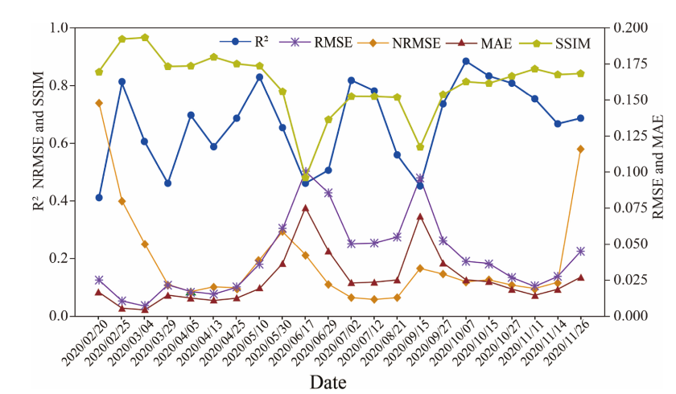
Seasonal analysis of prediction NDVI errors of different vegetation
types
Evaluation indicators:
coefficient of determination (R2), the root mean squared error (RMSE), the normalized root mean square error (NRMSE), the mean absolute error (MAE) and structural similarity index (SSIM)

Slide 30

Seasonal analysis of prediction NDVI errors of different vegetation
types

Slide 31
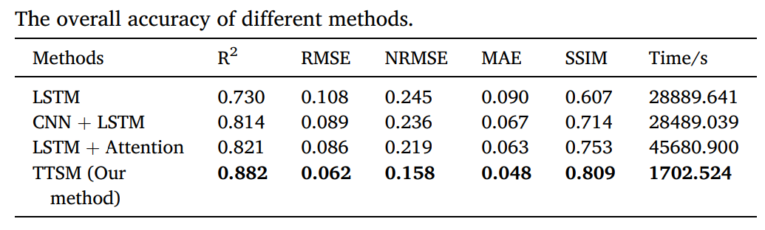
Comparison of TTSM and other methods

Slide 32
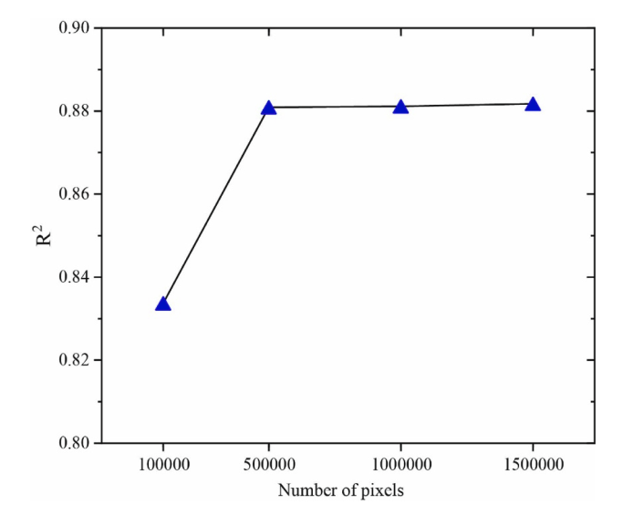
Effect of sample size on the TTSM model

Slide 33
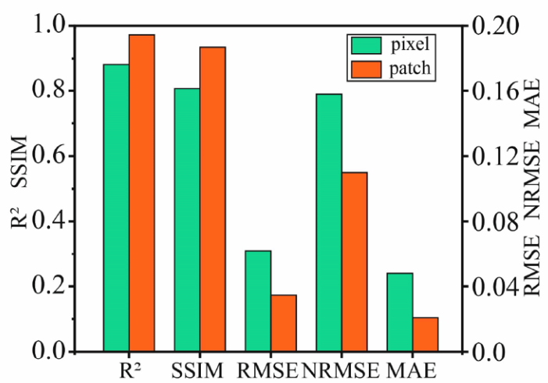
TTSM performance at the plot scale

Slide 34
Challenges of TTSM in vegetation NDVI prediction
SAR data still have much noise even after speckle filtering by the RefinedLee algorithm.
Unable to predict correctly for snow covered regions
low prediction accuracy due to abrupt change crop NDVI
mismatched time window in SAR data and optical data
Unsatisfactory results for mixed vegetation

Slide 35
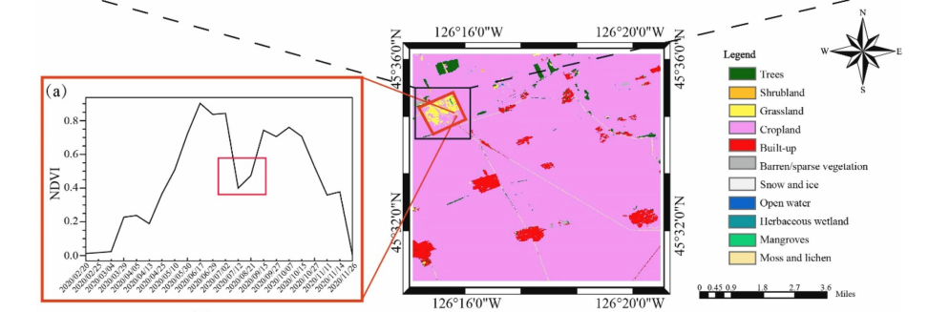
Challenges of TTSM in vegetation NDVI prediction

Slide 36
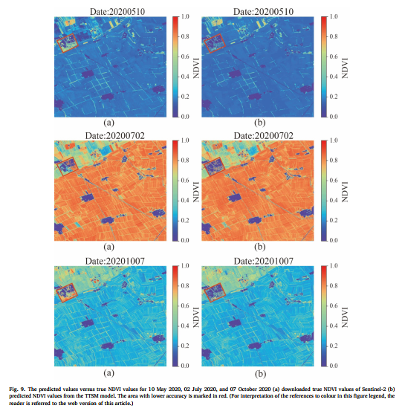
Challenges of TTSM in vegetation NDVI prediction

Slide 37
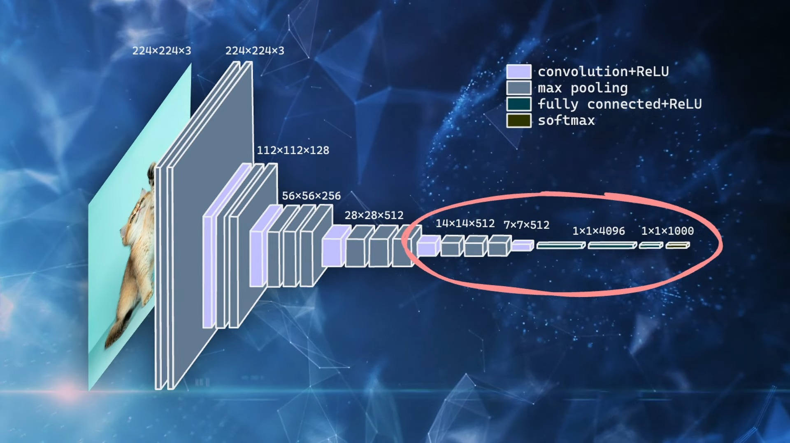
future works
Since the research aims at areas contaminated by clouds, it presupposes the ability to detect cloud-covered areas, which limits the application of our model. This problem will be further investigated and addressed.
Data fusion is conducted at raw SAR and optical data, and the feature-level and decision-level fusion is also interesting.
Exploiting the excellent spatial feature extraction capabilities of CNN to improve the computation cost of TTSM.

Slide 38
Thank you

